Slide 1
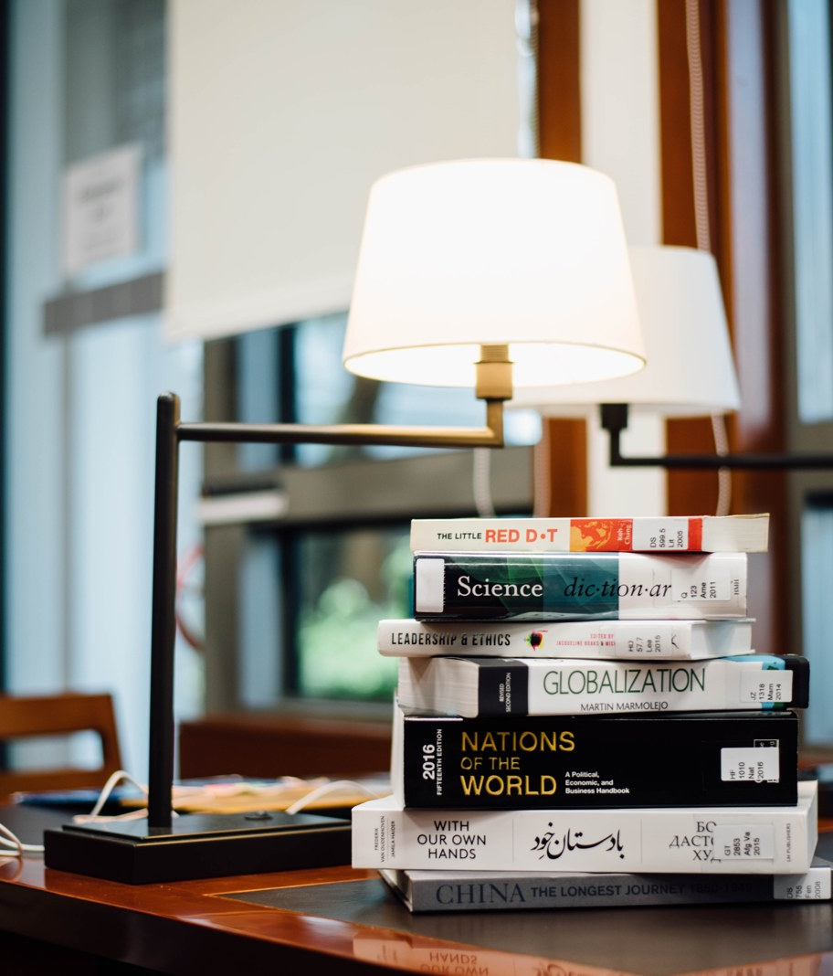
AN OVERNIGHT HISTORY TRIP
Gettysburg with Emma
Saturday October 24 to Sunday October 25, 2026.

Slide 2
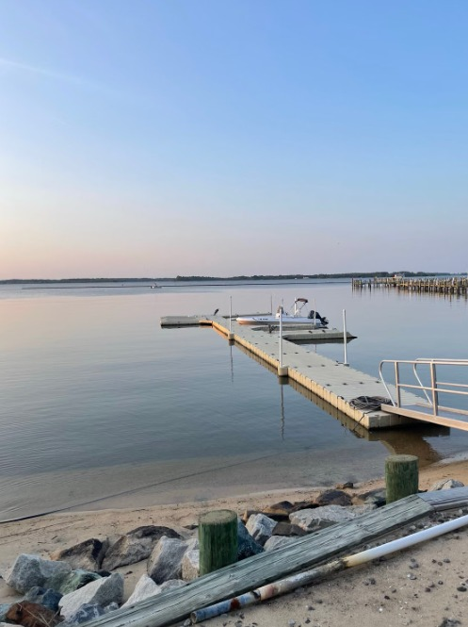
The shape of the weekend
1
• Two and a half hours of driving each way from Annapolis.
• One guided battlefield tour, taken at an easy pace.
• A quiet dinner and an early night at an inn near the square.
• A museum visit Sunday morning, then the drive home.
• Emma is reading the battlefield chapters before we go.
Gettysburg with Emma - October 24 to 25, 2026.

Slide 3
Saturday and Sunday
2
Time | Saturday, October 24
7:30 AM | Leave home. Coffee packed, inhaler taken.
11:00 AM | Licensed battlefield guide tour, about two hours.
3:00 PM | Little Round Top and the Pennsylvania Memorial, slow pace.
7:00 PM | Dinner near the square, early night.
Time | Sunday, October 25
9:30 AM | Museum, visitor center, and the cyclorama.
11:30 AM | Bookshop. Emma picks the next title for the reading pact.
12:30 PM | Lunch, then the drive home, arriving mid afternoon.
An easy pace, with frequent rests on the field.

Slide 4
What to pack
3
Category | Item | Status
Health | Rescue inhaler, front pocket | Packed
Health | Allopurinol for Saturday evening | Packed
Health | Two water bottles | To pack
Reading | Emma's battlefield chapters | She is reading ahead
Car | Fuel up and check tire pressure | Friday afternoon
Comfort | Layers and a light rain jacket | To pack
Health items first, then reading, then the car.

Slide 5
The point of the trip
The conversation as much as the history.

